Slide 1
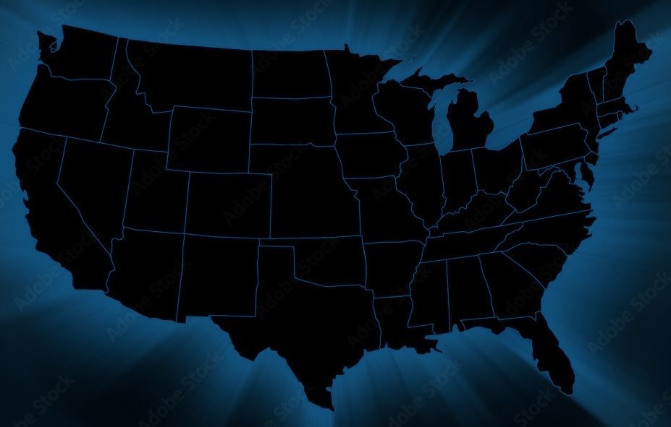

Gun Incidents in the USA
Data Mining project a.y. 23/24
Irene Dovichi - Giacomo Lagomarsini - Alice Nicoletta

Slide 2

Data Understanding
Data casting of the features
Handling of incoherent data
Data deduplication
Management of missing values
Elimination of useless columns:
state_house_district
state_senate_district
participant_age_group1
participant_gender1
notes
incident_characteristics2
similar to congressional_district
redundant
too many missing values

Slide 3


Incoherent Data
Some incidents occurred in years 2028 – 2030 None
5 incidents were in China changed the sign of longitude
Some features related to age were outside [0,100] None
Some incidents had a number of children / teens / adults outside [0,103] which is the interval of n_participants Null
Some instances had candidatevotes and totalvotes of -1, 0, 1 Null

Slide 4
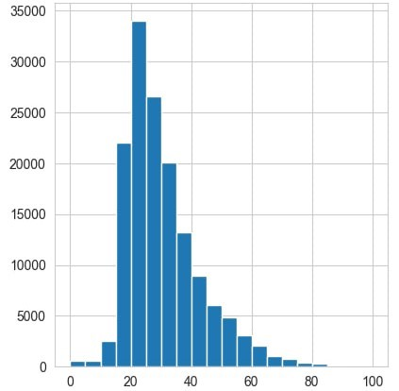

Missing Values
38% of the instances had missing values for the age features.
We addressed this issue for avg_age_participants as follows:
Calculate percentage of children / teens / adults
Define the distribution for each age group using the values of avg_age_participants in the given age group
Sample an age from each of the 3 distributions
Weighted mean of the 3 drawn ages (weights are percentages in 1.)
Before
After

Slide 5



Data Preparation
New features defined by us:
severity
severity_minor
killed_by_district
injured_by_district
female_ratio
arrested_ratio
unharmed_ratio
right_or_left
voters_over_population

Slide 6
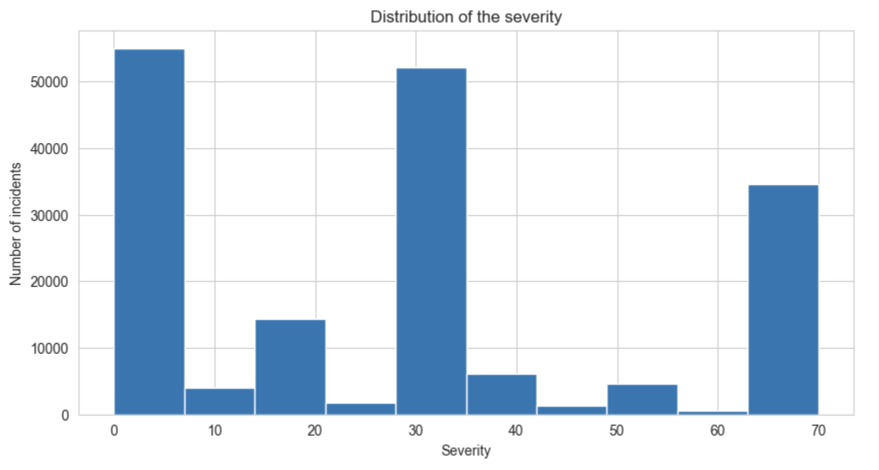
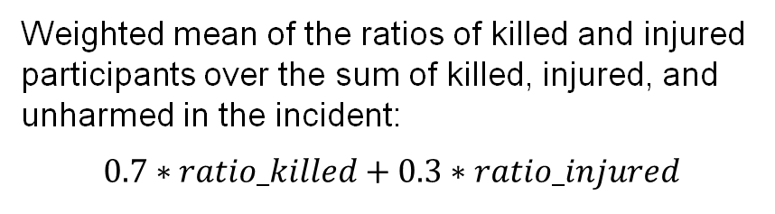
Data Preparation
New features defined by us:
Weighted mean of the ratios of killed and injured participants over the sum of killed, injured, and unharmed in the incident:
$$0.7∗ratio_killed+0.3∗ratio_injured$$
severity
severity_minor
killed_by_district
injured_by_district
female_ratio
arrested_ratio
unharmed_ratio
right_or_left
voters_over_population

Slide 7
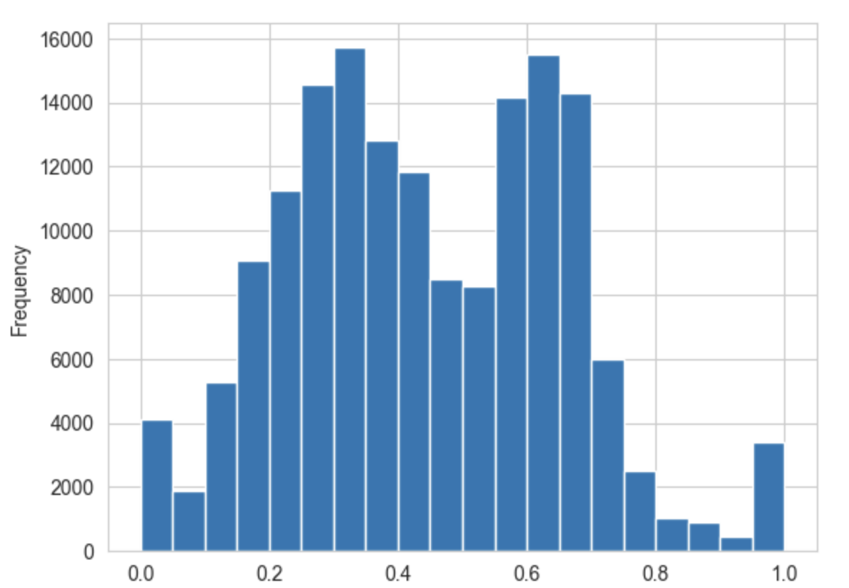
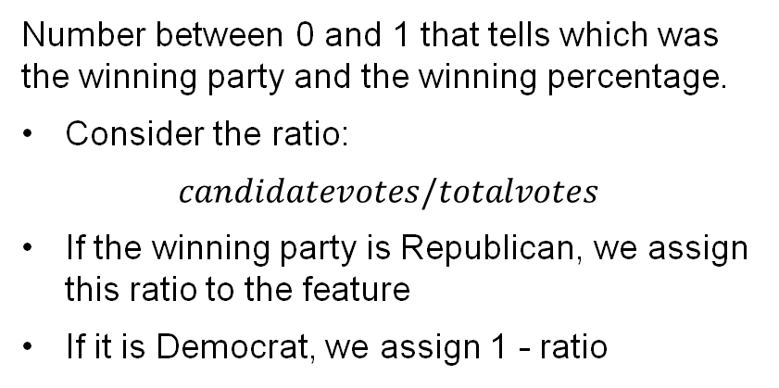
Data Preparation
New features defined by us:
Number between 0 and 1 that tells which was the winning party and the winning percentage.
Consider the ratio:
$$candidatevotes/totalvotes$$
If the winning party is Republican, we assign this ratio to the feature
If it is Democrat, we assign 1 - ratio
severity
severity_minor
killed_by_district
injured_by_district
female_ratio
arrested_ratio
unharmed_ratio
right_or_left
voters_over_population

Slide 8
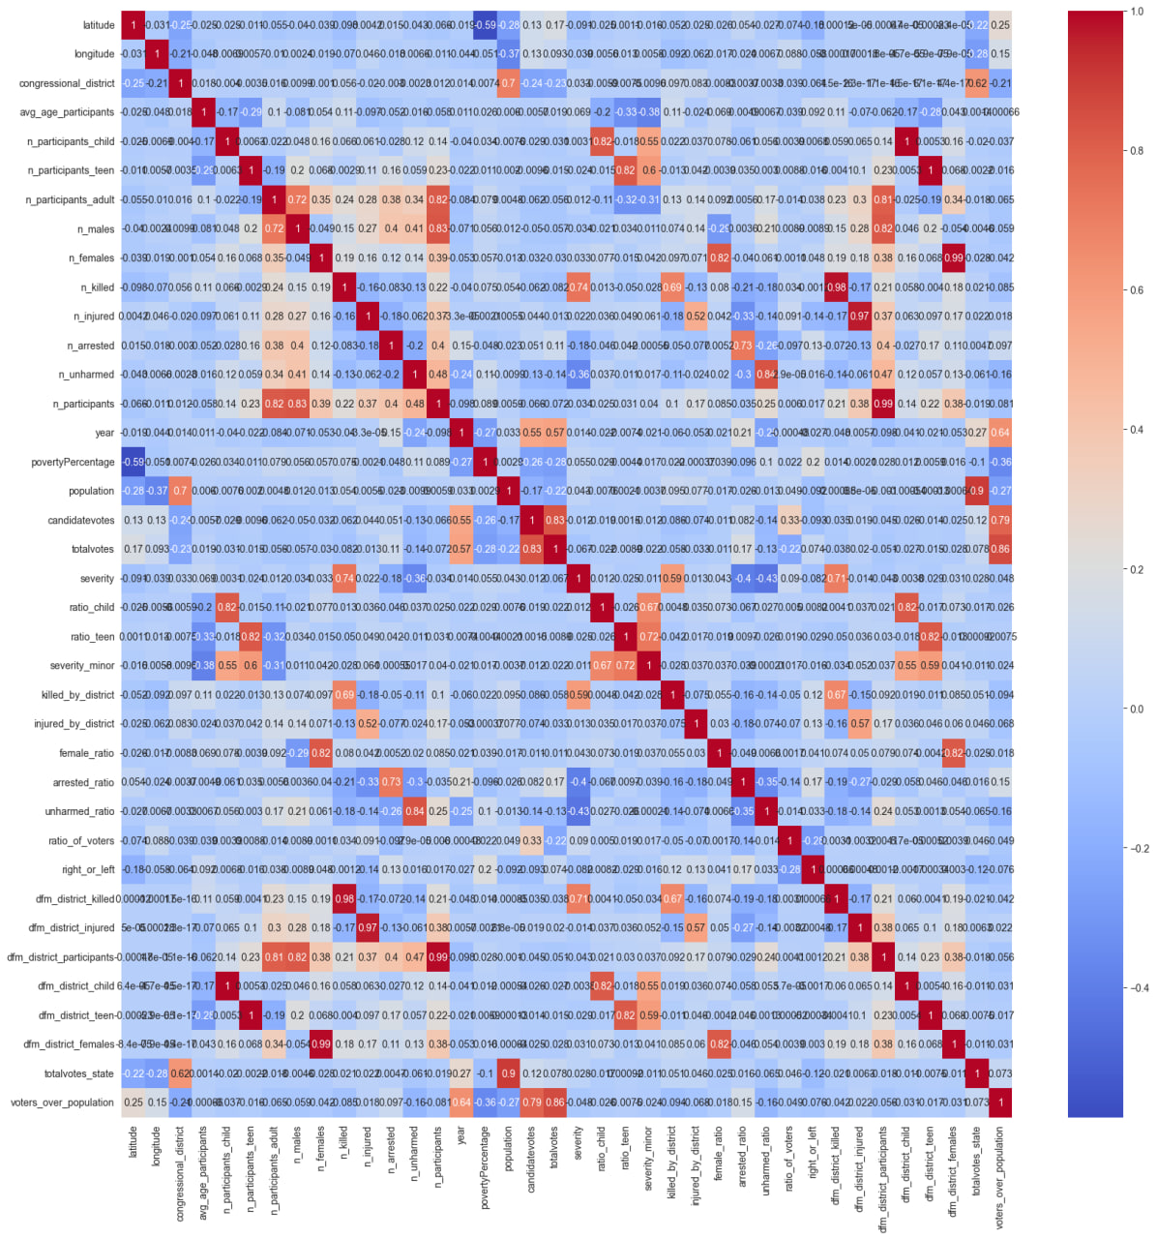
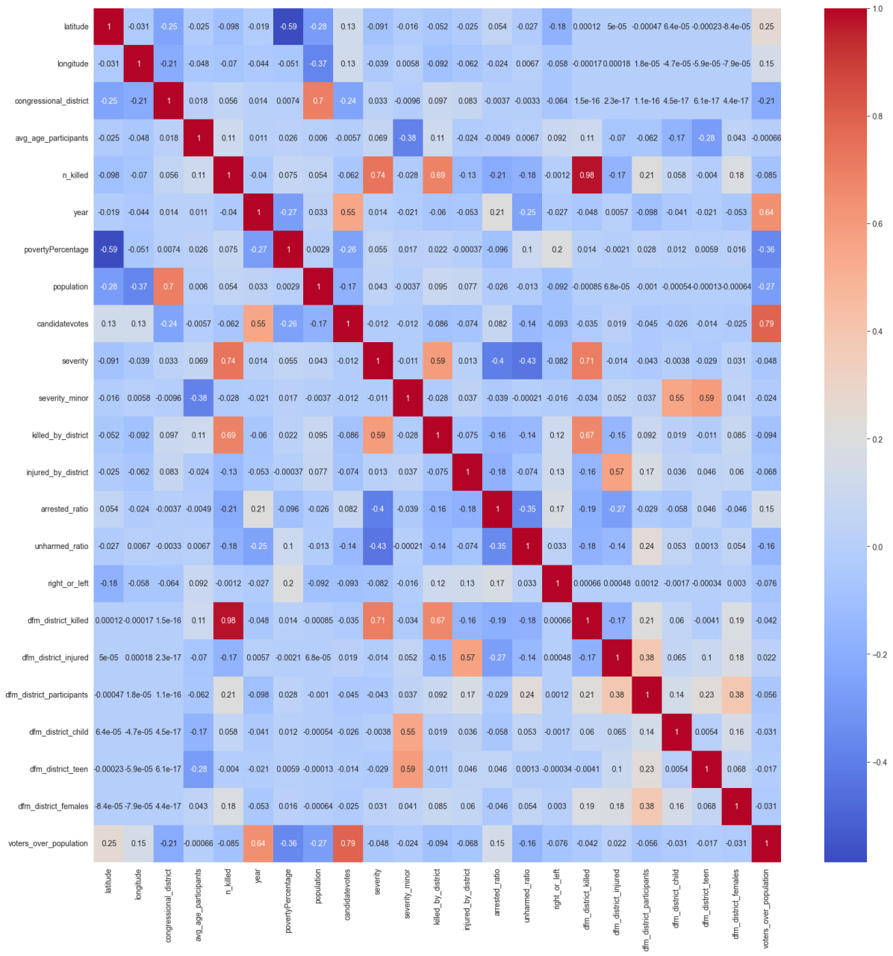
Correlation of Indicators
Correlations between all the features and the chosen ones, after analyzing pairs with correlation > 0.6

Slide 9
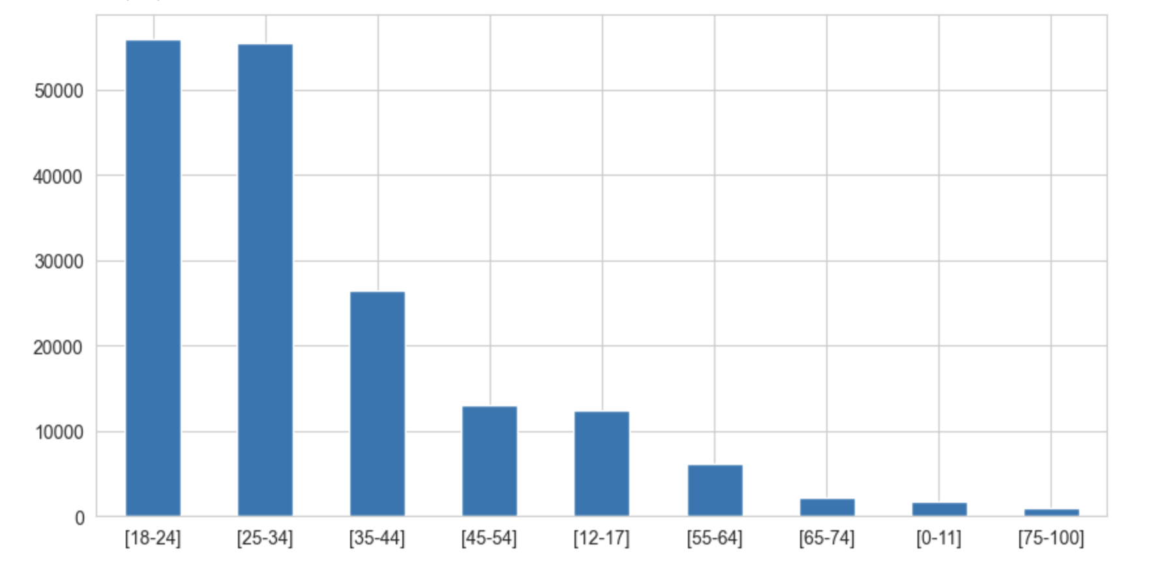
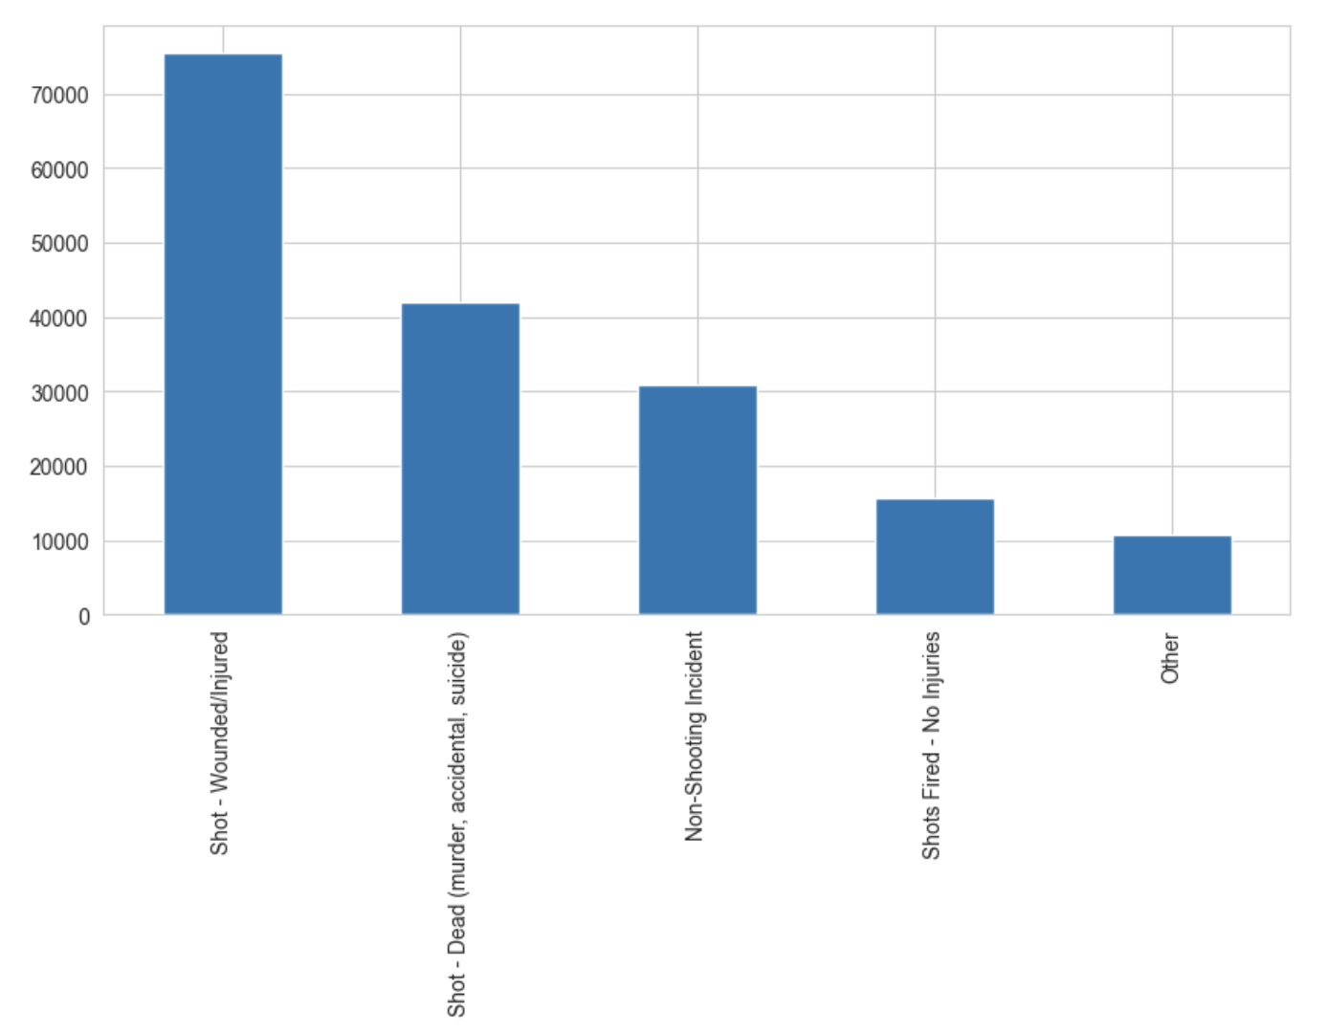
Feature Engineering
New feature age_group: discretization of avg_age_participants into 9 classes.
Reduction of incident_characteristics1 to its 4 most frequent labels + ‘Other’ label.

Slide 10
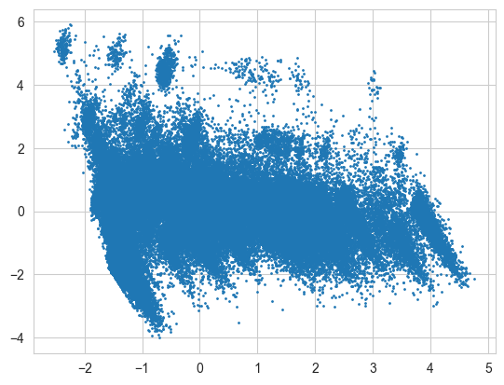
Clustering
Preprocessing
Choosing the features for clustering
Scaling (Standard or MinMax)
Better results with MinMax!
Principal Component Analysis
K-Means on whole Dataset
Density Based Clustering on single states
Hierarchical Clustering on single states

Slide 11
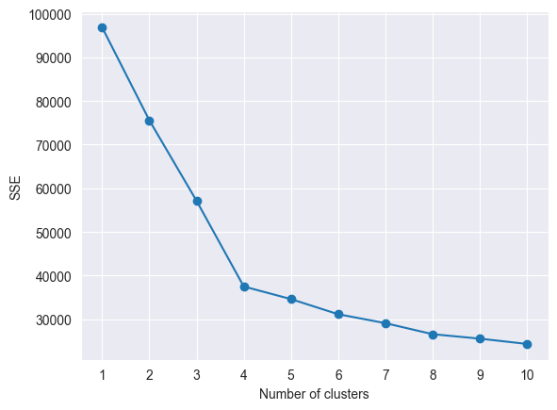
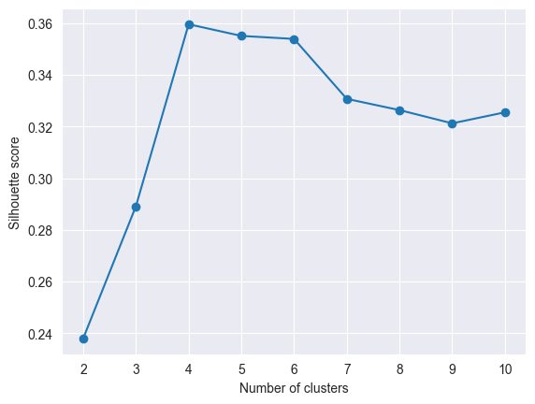
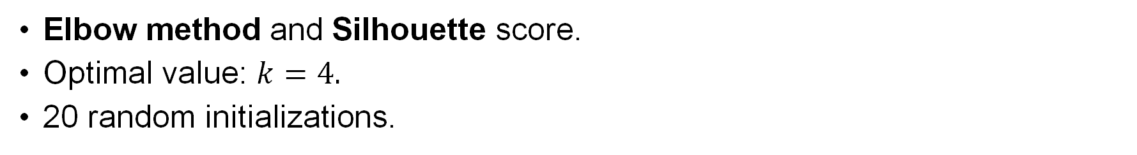
K-Means
Elbow method and Silhouette score.
Optimal value: $k=4.$
20 random initializations.

Slide 12
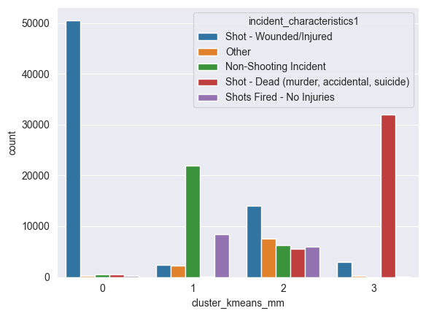
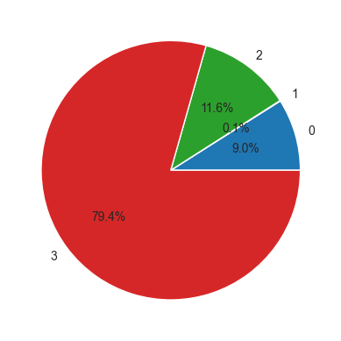
K-Means
External Information for goodness of clustering: characteristics of the incidents.
Percentage of killed people in each cluster:
Unsupervised measures: Silhouette = 0.36

Slide 13
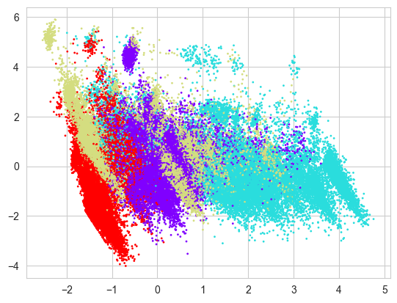
K-Means ++
K-Means++ Initialization (Arthur and Vassilvitskii, 2007):
Silhouette score of 0.64, cluster much better separated and cohesive

Slide 14
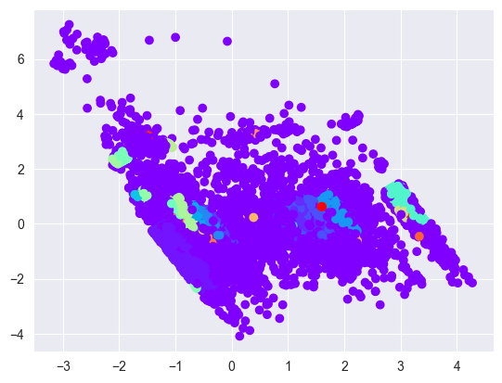
DBSCAN
Performed on California (state with most incidents)
One big cluster and some small other clusters, plus some noise points.
eps = 0.25
min_samples = 10,
chosen by looking at the distance from the k-th nearest neighbor

Slide 15
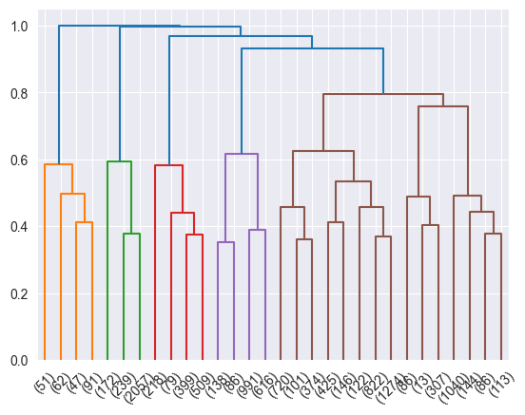
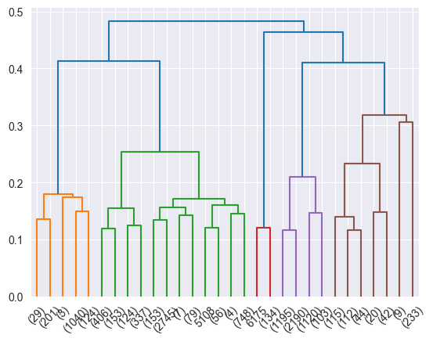
Hierarchical Clustering (California)
Techniques:
Single-link
Complete-link
Average
Ward
Two distances considered:
Euclidean distance
Cosine distance
Reported the best 2 configurations
complete link, cosine distance,
5 clusters
Silhouette = 0.47
average link,
cosine distance,
5 clusters
Silhouette = 0.50

Slide 16
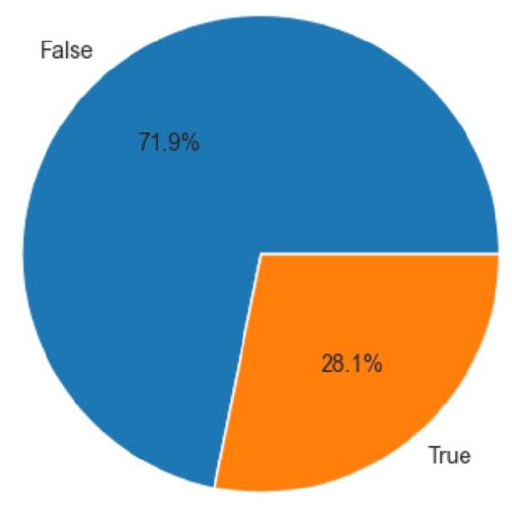
Classification
Classification task with isKilled as label
Several models used:
Logistic Regression
Decision Tree
K-NN
AdaBoost
Random Forest
Neural Network
80% of data used as training set, 20% as test set
Same split used throughout the whole analysis

Slide 17
Using all available features
We first tested Logistic Regression and Decision Tree on all current features.
Models appeared to be very accurate and classification "too easy»
Underlying linear relationship between features:
n_killed = n_participants - (n_injured + n_unharmed + n_arrested)
We removed n_injured, n_unharmed, n_arrested and tried again.

Slide 18
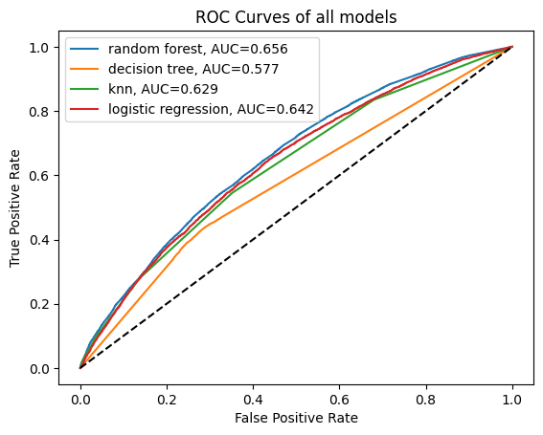
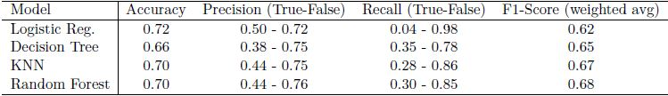
Discarding the Unharmed, Injured and Arrested
Tested on several models using 3-fold CV and Grid Search:
Logistic Regression
Decision Tree
K-NN
Random Forest
Very poor results on recall and precision, low AUC.

Slide 19
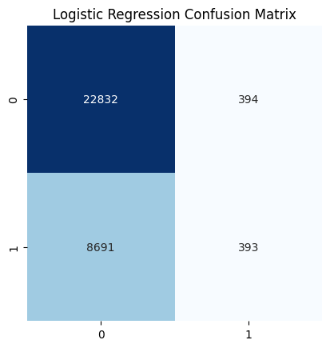
Relationship with majority-class Classifier
The baseline majority-class classifier, i.e. answering always False,
has a 72% accuracy.
Logistic Regression has a similar behaviour:
72% accuracy
0.04 true positive rate
0.98 true negative rate
Thus answering False almost everytime.

Slide 20
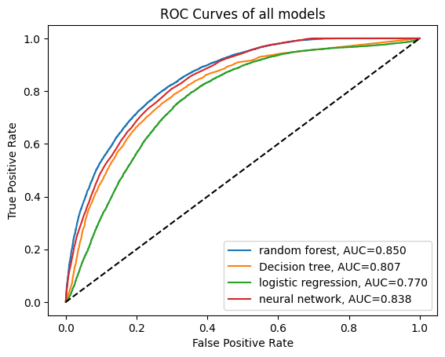
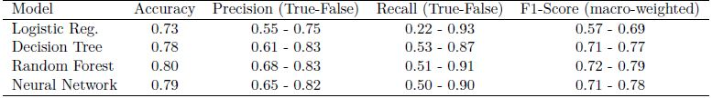
Reintroducing n_injured
Discarded K-NN
Introduced Feed-Forward Neural Network among models
Same form of assessment
Overall better and more interesting results.

Slide 21

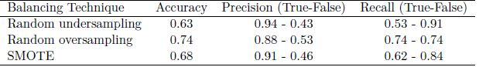
Attempt to balance the dataset
We decided to try to balance the dataset.
Some techniques deployed:
Random undersampling
Random oversampling
SMOTE.
This led to:
Less false negatives
Many more false positives
Worse accuracy overall, even lower than majority-class classifier (that answer always False).

Slide 22

Explanation Analysis
We selected three of our previous models:
Decision Tree
Random Forest
Neural Network
and performed global and local explanation analysis through:
SHAP
LIME
Additionally, we used EBM as explainable glassbox model and compared it to the other ones.

Slide 23
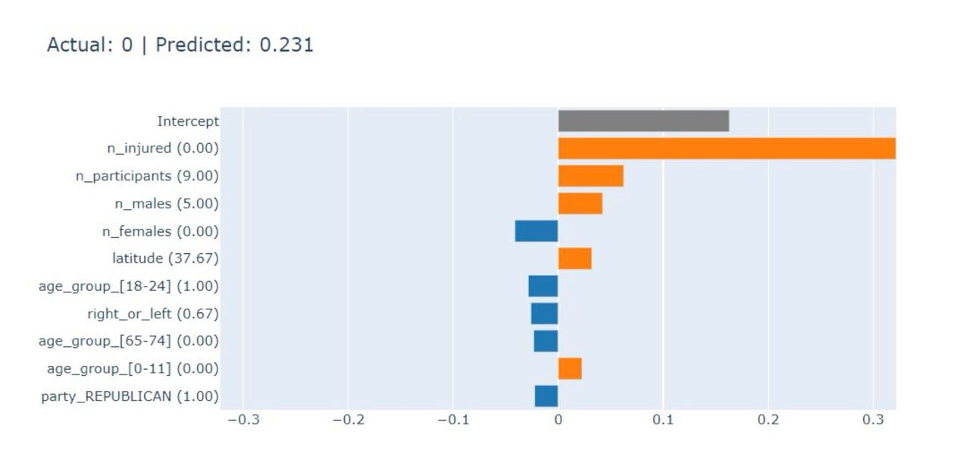
LIME on Random Forests
Example of local explanation with LIME:
We can see how the high number of participants and the zero injured are the features that are considered the most for the decision (no killed).

Slide 24
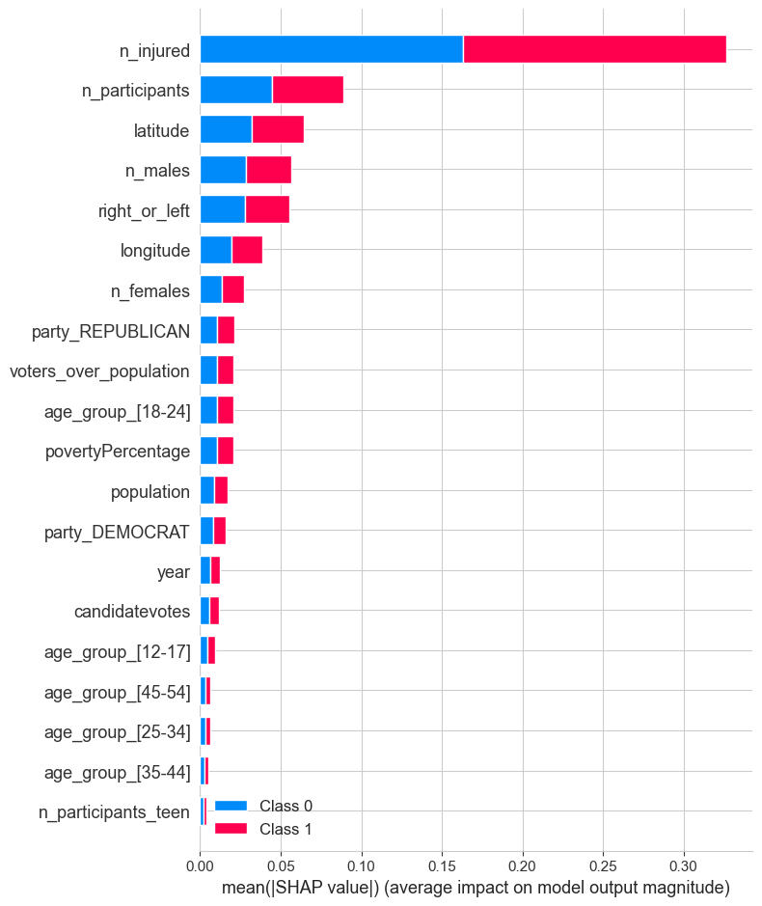
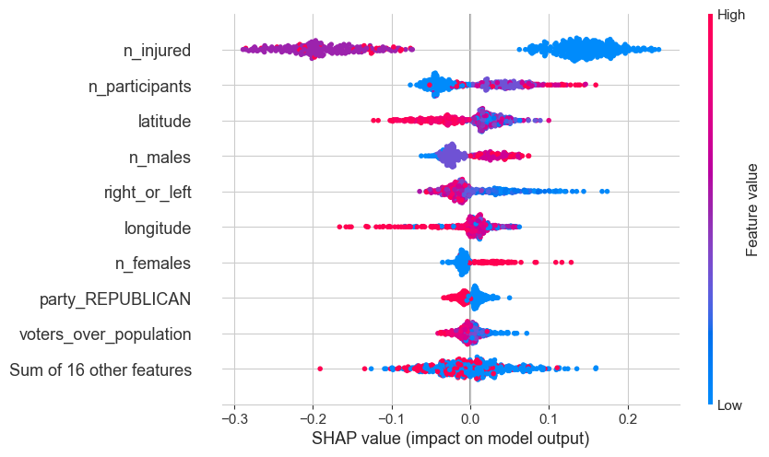
SHAP on Random Forests
Mean of Absolute SHAP Values
Beeswarm

Slide 25
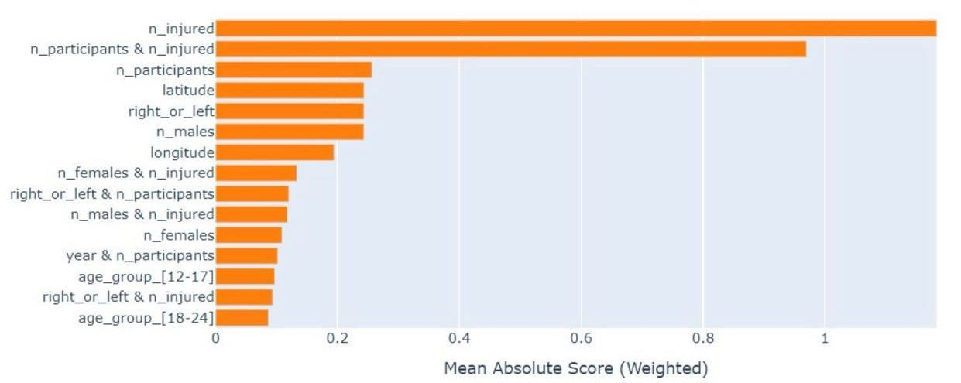
Explainable Boosting Machine
• Glass-box model, explainable by design
• Able to explain both globally and locally
• Classification results on pair with previous Random Forest
Global Explanation: mean of the scores.
We can see how the model recognizes the importance of the interaction between n_participants and n_injured

Slide 26

Thanks for the attention!

